Slide 1



X
Logo Company
Data Warehouse Project
ID/X Partners – Data Engineer
Presented by
Hendri Angkasa

Slide 2


Insert your photo here
Hendri Angkasa
Rakamin Academy
Data Science Bootcamp (Excellent Grade)
Business Intelligence Short Course (Good Grade)
Home Credit – Data Scientist VIX
id/x partners – Data Scientist VIX
Kimia Farma – Big Data Analytics VIX
Id/x partners – Data Engineer VIX
Data talent with background in engineering who is highly interested in data analysis, data science, data engineering and machine learning. Have 2 years of experience in data analysis and handling database, a dedicated professional with an aptitude for innovation, creative problem-solving, and analytical thinking. Experienced and proficient in using python and SQL. Highly determined to improve my technical skills as a data subject and have finished several bootcamps and certifications in data analysis & data science, and currently attending bootcamp of data engineering.
Coursera
Google Data Analytics
IBM Data Science
DeepLearning.ai – Machine Learning Specialization (attending)
DeepLearning.ai – Neural Networks and Deep Learning (attending)
Digital Skola
- Data Engineer Bootcamp (attending)

Slide 3
Case Study
Salah satu client dari ID/X Partners yang bergerak di bidang e-commerce memiliki kebutuhan untuk membuat sebuah Data Warehouse yang berasal dari beberapa tabel dari database sumber.
Data Warehouse ini nantinya terdiri dari satu tabel Fact dan beberapa tabel Dimension.

Slide 4
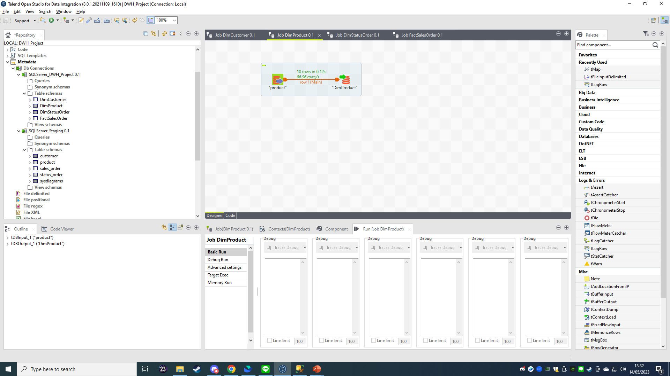
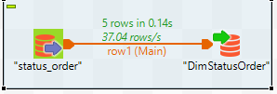
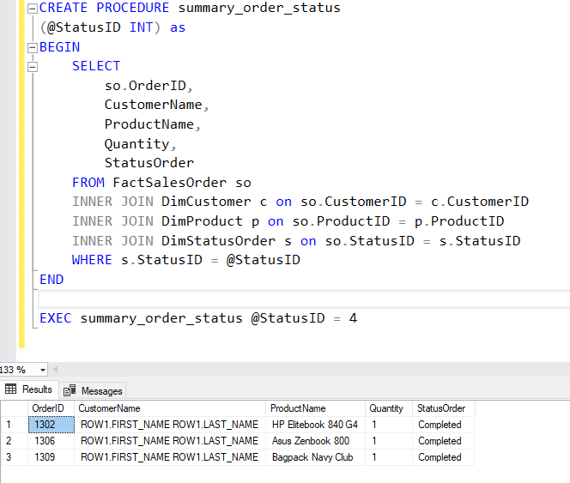

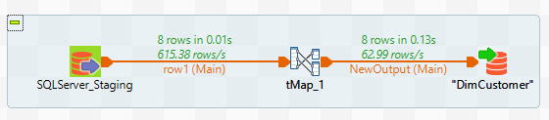
Hasil Data Warehouse Project
Berhasil melakukan ETL dari Data Lake menggunakan Talend
Berhasil menghasilkan Stored Procedure dengan parameter StatusID yang dapat digunakan untuk melihat data order berdasarkan status pengiriman.

Slide 5
For more details, please click link below
https://github.com/hendriangkasa/Data-Warehouse-Project-Data-Engineer

Slide 6

Video

Slide 7
Thank You
X
Logo Company

